Slide 1
In-class Exercise 06 - Gaussian Filter
Dhiren Gupta
-800902466

Slide 2
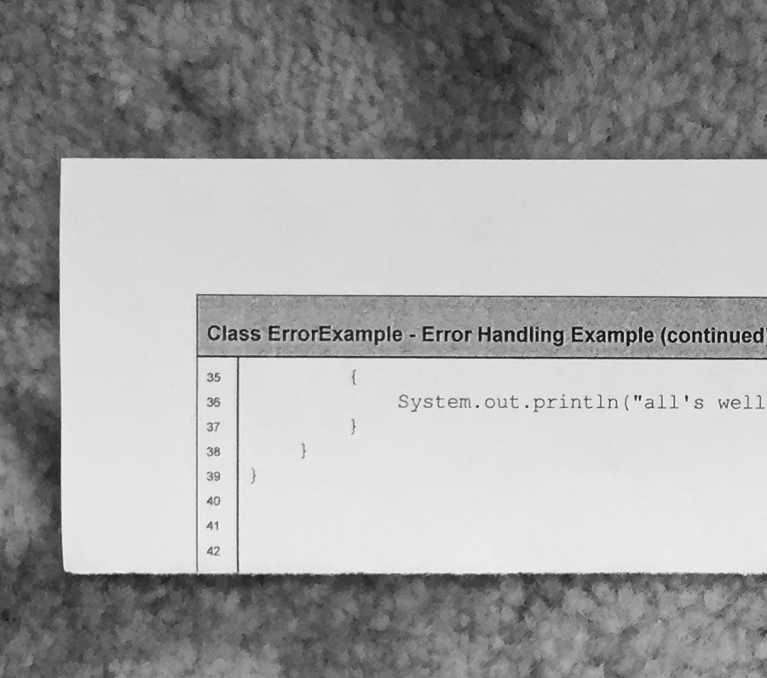
Input Image

Slide 3
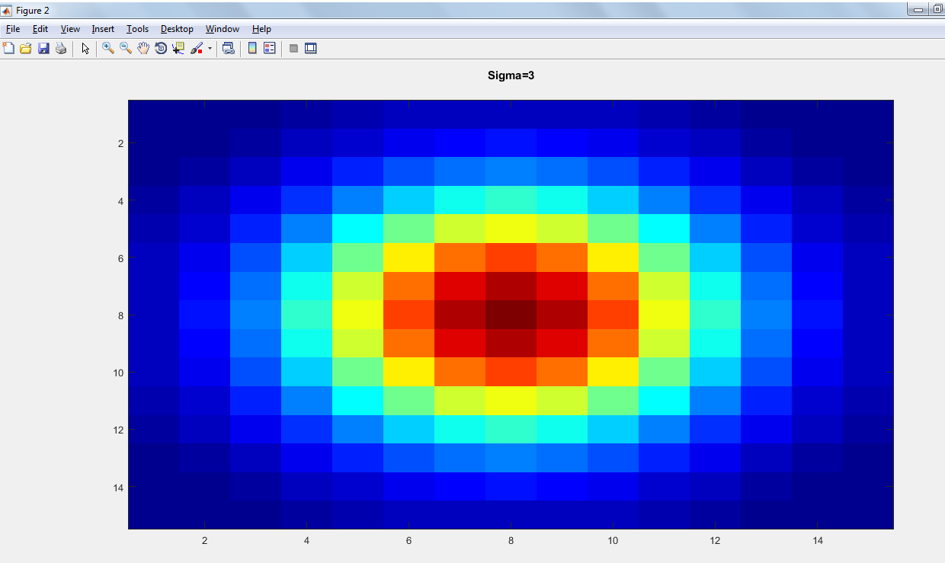
Sigma = 3.0 Kernel Visualization

Slide 4
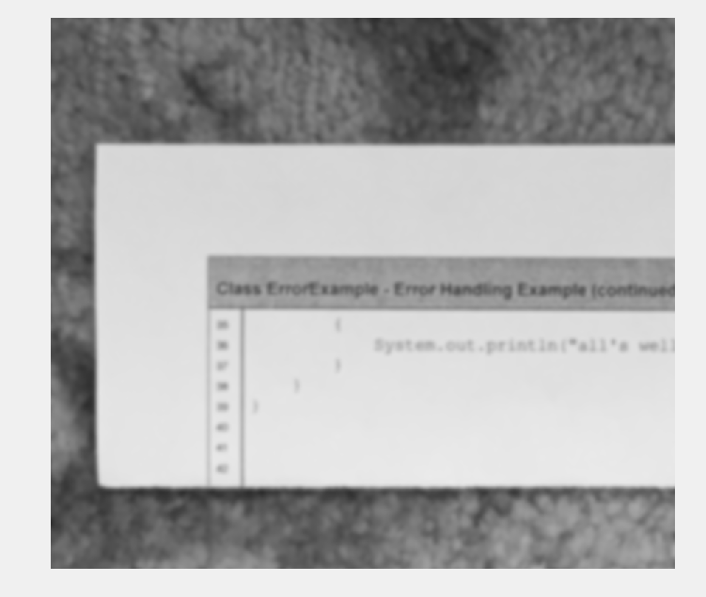
Sigma=3.0 Output Image

Slide 5
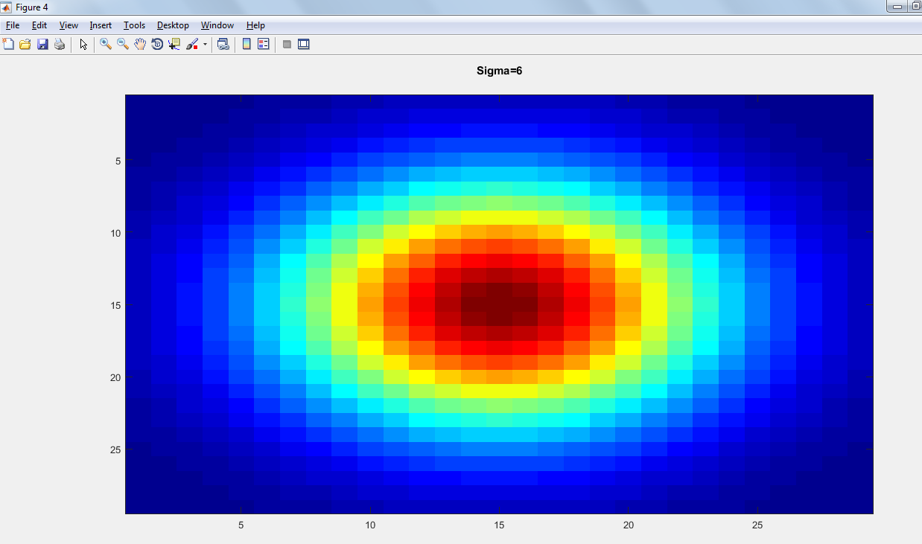
Sigma = 6.0 Kernel Visualization

Slide 6
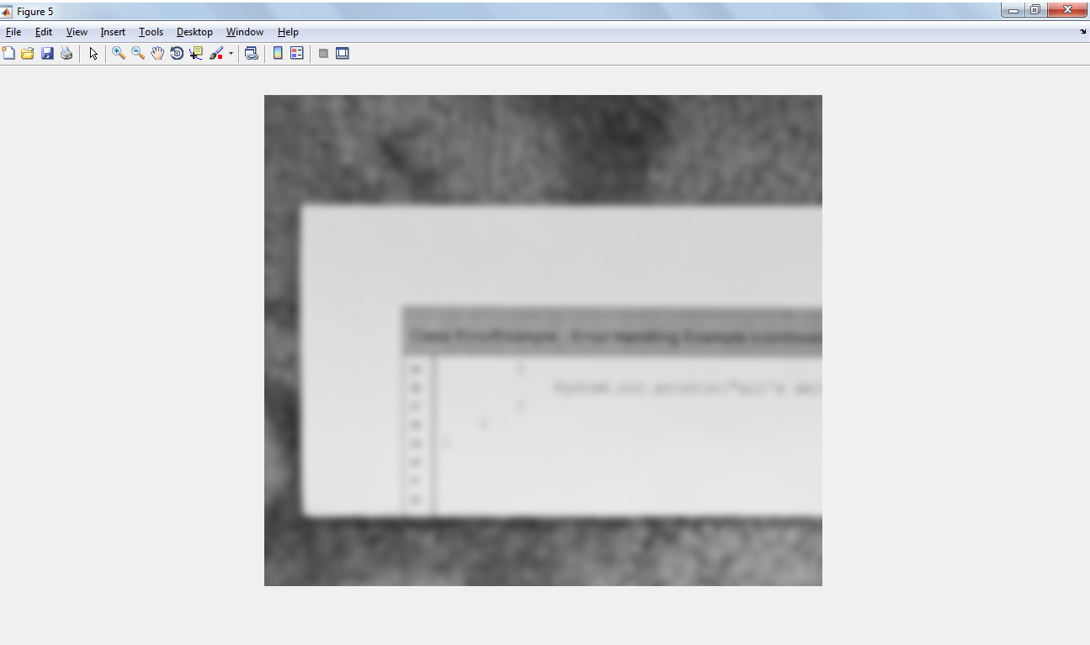
Output Image

Slide 7

Sigma = 9.0 Kernel Visualization

Slide 8
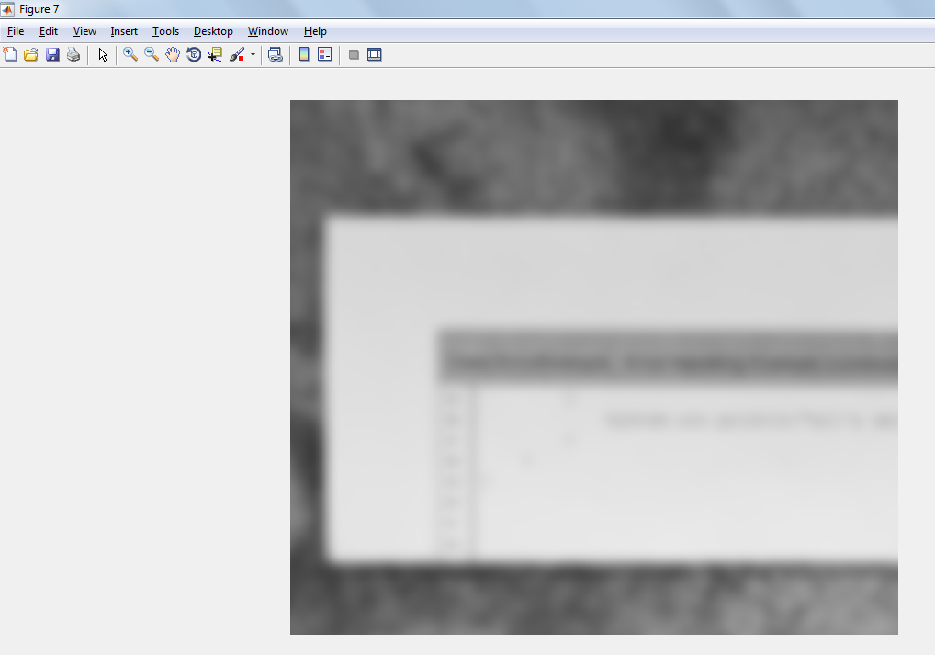
Output Image

Slide 9
Thank You

